Slide 1
B 2 5 F I T L E V E L 0 1 P R O J E C T
Compact Smart Hydro-Dipping Workstation with Automated Chemical Handling and Safety-Controlled Process Monitoring
Project Proposal
Index No. | Name | Programme
254037B | CHAMIDYA J.A.S | Information Technology
254048J | DE SILVA P.S.S | Information Technology
255078H | OMESH N.A.N | IT & Management
254101R | KALANSOORIYA O.K | Information Technology
255027D | GOONATILLAKA W.A.D.S.S | IT & Management
Degree Programmes: BSc (Hons) in Information Technology / BSc (Hons) in Information Technology & Management
Supervisor :

Slide 2
Introduction
Hydro-dipping (water transfer printing) applies a printed pattern onto a 3D object by floating a special film on water, activating it with a chemical solvent, and dipping the object through the film.
Widely used in automotive trim, sports equipment, phone accessories, and small-scale product customization.
Conventional hydro-dipping is almost entirely manual — an operator handles film placement, spraying, and dipping by hand, usually in an open or lightly ventilated space.
Manual handling causes inconsistent coating quality and repeated direct exposure to activator fumes, with no real monitoring of chemical concentration or process conditions.
This project introduces a compact, semi-automated workstation that automates the core stages of the process and adds sensor-based monitoring inside an enclosed, ventilated housing.
Core Process Automated by This System
Film Placement
Activator Spray
Controlled Dipping
Drying & Ventilation
Smart Hydro-Dipping Workstation
2

Slide 3
Aim & Objectives
Aim: To design and develop a compact, semi-automated hydro-dipping workstation that performs controlled hydrographic coating with improved consistency, operator safety, and reduced chemical exposure, using sensor-based monitoring and enclosed operation.
Primary Objectives
Technical Objectives
Develop a compact automated hydro-dipping system
Improve coating consistency compared to manual dipping
Reduce direct human exposure to activator chemicals
Integrate multiple industrial-grade sensors for monitoring and safety
Implement controlled dipping and drying operations
Build a safe enclosed workstation with ventilation control
Design a precise dipping mechanism with controlled movement
Implement sensor-driven automation using embedded systems
Develop a controlled activator spray subsystem
Create a safe power distribution architecture
Design fail-safe emergency shutdown operations
Monitor environmental conditions inside the enclosure
Smart Hydro-Dipping Workstation
3

Slide 4
Problem Statement & Proposed Solution
The Problem
The Proposed Solution
Inconsistent Coating Quality
Uneven dipping speed, incorrect angles, film distortion and air bubbles reduce print quality.
Compact enclosed workstation with automated process control and integrated safety monitoring
Controlled film handling and precision dipping automation
Intelligent, sensor-timed activator spraying
Sensor-based environmental and chemical monitoring
Enclosed chemical containment with automated drying & ventilation
Emergency safety interlocks throughout the whole system
Chemical Exposure Risk
Activator fumes irritate skin, eyes and lungs; most small setups lack containment or ventilation.
Lack of Process Control
Spray timing, water conditions and dipping precision cannot be controlled manually, hurting repeatability.
Unsafe Hobby-Level Systems
Exposed chemicals, no emergency shutdown, no monitoring — unsuitable for a controlled environment.
Smart Hydro-Dipping Workstation
4

Slide 5
System Block Diagram — How It Works
ENCLOSED WORKSTATION HOUSING
POWER BLOCK
ACTUATORS / OUTPUTS
- 230V AC Mains + Safety
- SMPS (24V / 12V / 5V Rails)
5V Power
- Dipping Stepper (NEMA17)
- Activator Solenoid Valve
- Film Feed Roller Motor
- Exhaust Fans & Carbon Filter
- PTC Ceramic Drying Heater
Control Signals
ESP32
Industrial Dual-Core Controller
SENSORS / INPUTS
- Water Temp (PT100 RTD Sensor
+ MAX31865 Amplifier Module)
- Water Level (JSN-SR04T 2.0 Water-
proof Ultrasonic Ranging Module)
- VOC/Gas Sensor (ENS160)
- Limit Switches & Leak Sensor
- Airflow Sensor & Rotary Encoder
DISPLAY / UI
Input Data
Display Data
- LCD Touchscreen Interface
- Status Indicators / Wi-Fi Dash
Smart Hydro-Dipping Workstation
5

Slide 6
Operational Flow — Power On to Completion
1
System Initialization
Sensor, fan, water level, door-lock & E-Stop checks; system enters READY state.
2
User Input
Film length, dipping mode & drying duration entered via LCD / touchscreen.
3
Film Feeding
Motorized roller pulls, measures & places film on the water surface.
4
Water Stabilization
Sensors confirm temperature & surface stability before proceeding.
5
Activator Spray
Solenoid nozzle sprays for a calibrated duration; VOC sensor halts spray if fumes exceed threshold.
6
Automated Dipping
Stepper-driven linear rail lowers the object smoothly; limit switches guard travel range.
7
Extraction
Object is lifted slowly; excess liquid drains back into the tank.
8
Drying & Ventilation
Exhaust fans (+ PTC heater) dry the object while VOC is monitored.
9
Safe Completion
Enclosure unlocks once fumes clear and drying finishes; system resets to READY.
Example Cycle: A car dashboard trim panel is processed — 25 cm of film is fed and placed on the water, activator is sprayed for 4 seconds, the panel is dipped and extracted over about 12 seconds, then dried for 6 minutes with the exhaust fan on high before the enclosure unlocks.
Smart Hydro-Dipping Workstation
6

Slide 7
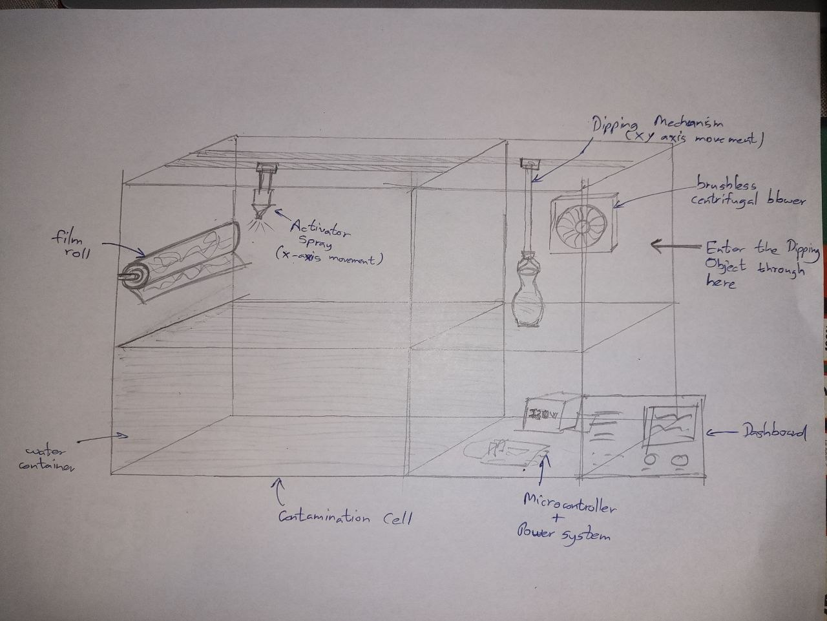
Mechanical Concept Sketch
Space reserved for the hand-drawn concept sketch of the dipping platform, enclosure and roller layout
Smart Hydro-Dipping Workstation
7

Slide 8
Hardware Components
Function | Selected Component
Main Controller | ESP32 Industrial Development Board
Water Temperature | PT100 RTD + MAX31865 Amplifier
Water Level | Industrial Ultrasonic Sensor
VOC / Chemical Gas | SGP30 / ENS160 Air Quality Sensor
Position Detection | Omron Industrial Limit Switches
Leak Detection | Capacitive Liquid Leak Sensor
Airflow Verification | Hall-Effect Airflow Sensor
User Interface | LCD Touchscreen / Rotary Encoder + LCD
Function | Selected Component
Linear Motion | MGN12 Linear Rail + Lead Screw System
Drive Motor | NEMA 17 Stepper Motor
Motor Driver | TMC2209 Silent Driver
Spray Nozzle | HVLP Fine Mist Nozzle
Spray Valve | 12V Solenoid Valve
Exhaust Fan | Brushless Centrifugal Fan
Filtration | Activated Carbon Filter
Drying Heater | PTC Ceramic Heater (Low Power)
Smart Hydro-Dipping Workstation
8

Slide 9
Power System Design
230V AC
Mains
AC Protection
Fuse / MCB / EMI
Filter / E-Stop Relay
SMPS
Conversion
24V DC Rail
Stepper motors, exhaust fans, solenoid valve
12V DC Rail
Spray system & auxiliary devices
5V DC Rail
ESP32 controller & sensor logic
Safety Features Built Into the Power System
Emergency Stop — instantly cuts power to motors, spray system & heater, while keeping the controller alive for diagnostics.
Separate Logic & Motor Power — prevents motor electrical noise from affecting sensitive sensor readings.
Ground Fault Protection — critical given the close proximity of electronics to water.
Smart Hydro-Dipping Workstation
9

Slide 10
Software Components & Technologies
Embedded Firmware
C / C++ on the Arduino framework (or ESP-IDF) for the ESP32; FreeRTOS dual-core task scheduling for parallel sensor polling and actuator control.
Monitoring & Connectivity
ESP32 WiFi / Bluetooth for an optional companion dashboard, live sensor logging and remote status alerts.
Communication Protocols
I2C for the gas sensor & touchscreen, SPI for the MAX31865 RTD amplifier, UART for debug logging, PWM for stepper and fan speed control.
Development & Design Tools
Arduino IDE / PlatformIO for firmware; Fusion 360 / KiCad for mechanical & PCB design; Git for version control.
User Interface Software
LCD / touchscreen driver library (e.g. LVGL or TFT_eSPI) for menu navigation, live status display and input handling.
Smart Hydro-Dipping Workstation
10

Slide 11
Detailed Project Budget
Component | Qty | Est. (LKR)
ESP32 Industrial Dev. Board | 1 | 3,500
PT100 RTD Sensor | 1 | 2,500
MAX31865 Amplifier Module | 1 | 1,800
Industrial Ultrasonic Sensor | 1 | 6,500
VOC / Air Quality Sensor | 1 | 3,200
Omron Limit Switches | 4 | 3,800
Capacitive Leak Sensor | 2 | 3,000
Hall-Effect Airflow Sensor | 1 | 2,200
MGN12 Rail + Lead Screw Set | 1 | 7,500
NEMA17 Stepper Motor | 1 | 3,000
TMC2209 Driver Module | 1 | 1,600
HVLP Spray Nozzle | 1 | 2,000
Component | Qty | Est. (LKR)
12V Solenoid Valve | 1 | 2,800
Brushless Centrifugal Fan | 2 | 7,000
Activated Carbon Filter | 2 | 3,600
PTC Ceramic Heater | 1 | 2,500
LCD Touchscreen / Encoder | 1 | 5,500
SMPS Units (24V/12V/5V) | 3 | 7,500
Wiring, Connectors, Terminals | lot | 4,000
Enclosure Frame & Panels | lot | 15,000
Chemical-Resistant Water Tank | 1 | 6,000
Fasteners & Mounting Hardware | lot | 3,000
PCB Fabrication / Prototype Board | 1 | 4,500
Subtotal: LKR 102,000 Contingency (10%): LKR 10,200 Estimated Total: LKR 112,200
Smart Hydro-Dipping Workstation
11

Slide 12
Project Timeline — 10 Months
M1
M2
M3
M4
M5
M6
M7
M8
M9
M10
Literature Review & Requirement Analysis
System Design & Component Selection
Procurement of Components
Mechanical Assembly (Rail, Platform, Enclosure)
Sensor Integration & Firmware Development
Power System Assembly & Safety Testing
Spray & Ventilation Subsystem Integration
Full System Integration
Testing, Calibration & Debugging
Documentation & Final Presentation
Smart Hydro-Dipping Workstation
12

Slide 13
Work Distribution
Member | Assigned Sensor | Hardware Module(s) | Key Responsibilities
254037B CHAMIDYA J.A.S (IT) | Water Temperature (PT100 + MAX31865) | Water Stabilization & Heating Logic | Temperature sensing firmware & water-condition checks before spray.
254048J DE SILVA P.S.S (IT) | Water Level & Leak Detection | Tank & Leak Monitoring Module | Water level logic, leak-triggered safety cut-off integration.
255078H OMESH N.A.N (ITM) | VOC / Gas Sensors (ENS160) | Ventilation & Filtration (Fans + Carbon Filter) | Fume monitoring, exhaust control logic, IoT dashboard/alerts.
254101R KALANSOORIYA O.K (IT) | Position Limit Switches | Motion Control (Rail, Stepper, TMC2209) | Dipping-axis motion control, travel-limit safety logic.
255027D GOONATILLAKA W.A.D.S.S (ITM) | Airflow Sensor & Rotary Encoder | Drying Mechanism | Exhaust control, film feed logic
All members jointly contribute to overall ESP32 firmware architecture, system integration, and testing of safety interlocks across subsystems.
Smart Hydro-Dipping Workstation
13

Slide 14
Why This Project Stands Out
Strong Real-World Relevance
Solves real problems in small-scale manufacturing, automotive customization and product finishing.
Balanced Engineering Scope
Not over-mechanical or over-software-heavy — a well-balanced embedded systems project.
Strong Safety Engineering
Directly addresses chemical exposure, ventilation and electrical isolation, which most student projects ignore.
Industrial Thinking
Resembles a miniature smart manufacturing workstation rather than a hobby prototype.
Excellent for Evaluation
Demonstrates embedded systems, sensor integration, automation, power electronics and safety engineering in one project.
Smart Hydro-Dipping Workstation
14

Slide 15
References
[1] Espressif Systems, "ESP32 Series Datasheet," 2023.
[2] Texas Instruments, "PT100 RTD Temperature Sensing Reference Design," 2022.
[3] Maxim Integrated / Analog Devices, "MAX31865 RTD-to-Digital Converter Datasheet," 2021.
[4] Sensirion AG, "SGP30 Multi-Pixel Gas Sensor Datasheet," 2022.
[5] ScioSense, "ENS160 Digital Air Quality Sensor Datasheet," 2023.
[6] TRINAMIC Motion Control, "TMC2209 Datasheet — Silent StepStick Driver," 2022.
[7] Omron Corporation, "General Purpose Limit Switch Catalogue," 2021.
[8] Pepperl+Fuchs, "Ultrasonic Sensors for Level Measurement — Technical Guide," 2022.
[9] M. P. Groover, "Fundamentals of Modern Manufacturing: Materials, Processes and Systems," Wiley, 2020.
[10] Manufacturer application notes on hydrographic (water transfer) printing process fundamentals.
Smart Hydro-Dipping Workstation
15

Slide 16
Thank You
Questions & Discussion
Compact Smart Hydro-Dipping Workstation • B25 FIT Level 01 Project

